Slide 1
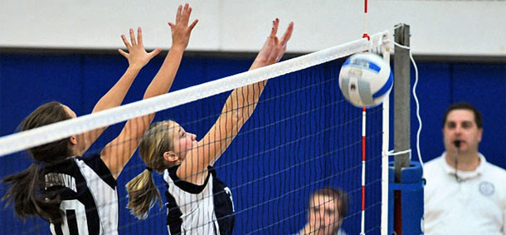
Shifting from Subtractive to Additive Grading to Improve Participation, Comprehension, Creativity, and Morale
Dr. Ken J. Ward, assistant professor of communication and media, Lamar University
kenjward.com | kenneth.ward@lamar.edu | SHSU TLC 2019

Slide 2
Shifting from Subtractive to Additive Grading to Improve Participation, Comprehension, Creativity, and Morale
Dr. Ken J. Ward, assistant professor of communication and media, Lamar University
kenjward.com | kenneth.ward@lamar.edu | SHSU TLC 2019

Slide 3
100

Slide 4
100
traditional grading

Slide 5
100
additive grading

Slide 6
MY GOAL
To show additive grading is an option and share ways you can put it to work.

Slide 7
MY GOAL IS NOT
To suggest additive grading is right for every course. It’s not.

Slide 8
What is additive grading?

Slide 9
ADDITIVE GRADING
A grading scheme in which students can complete as many or as few assessments as they choose from a pool of potential assignments, adding points to their grade with each successful attempt.

Slide 10
further, additive grading
awards students a final grade that accurately reflects their successes, not their failures; their grade can climb as high as they choose.

Slide 11
Pedagogical basis

Slide 12
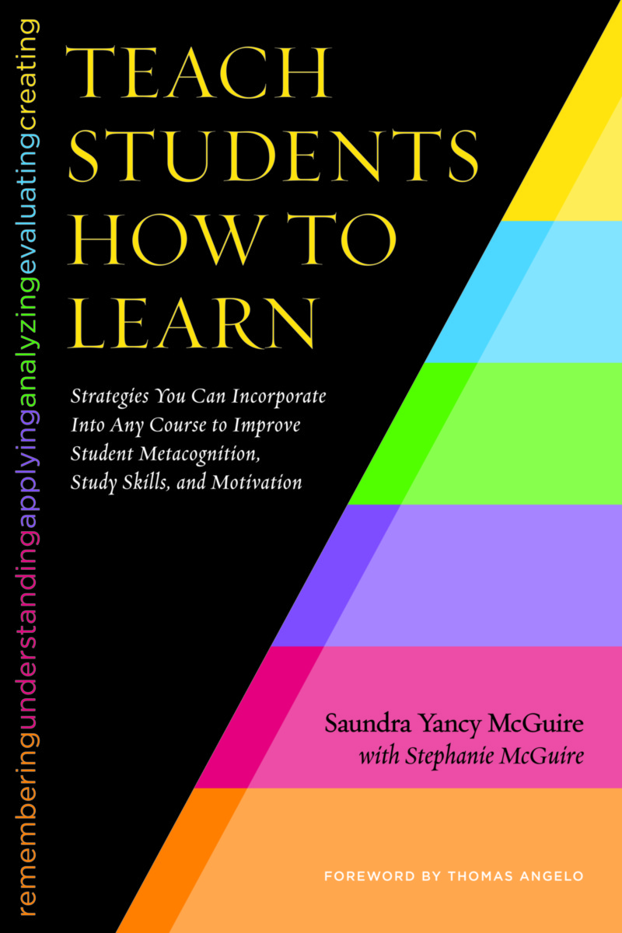
SAUNDRA YANCY MCGUIRE

Slide 13
SAUNDRA YANCY MCGUIRE
Feeds intrinsic motivation

Slide 14
SAUNDRA YANCY MCGUIRE
Feeds intrinsic motivation
Primes metacognition

Slide 15
SAUNDRA YANCY MCGUIRE
Feeds intrinsic motivation
Primes metacognition
Fosters growth mindset

Slide 16
KEN BAIN

Slide 17
KEN BAIN
Outcomes-based

Slide 18
KEN BAIN
Outcomes-based
Places trust in students

Slide 19
KEN BAIN
Outcomes-based
Places trust in students
Feeds intrinsic motivation (it’s worth saying twice)

Slide 20
KEN BAIN
Outcomes-based
Places trust in students
Feeds intrinsic motivation
Provides opportunities for safe failure

Slide 21
How to do it

Slide 22
STEP 1
(Re)conceptualize course from the top down to identify assessments

Slide 23
wishes
goals
goal components
outcomes
potential assessments

Slide 24
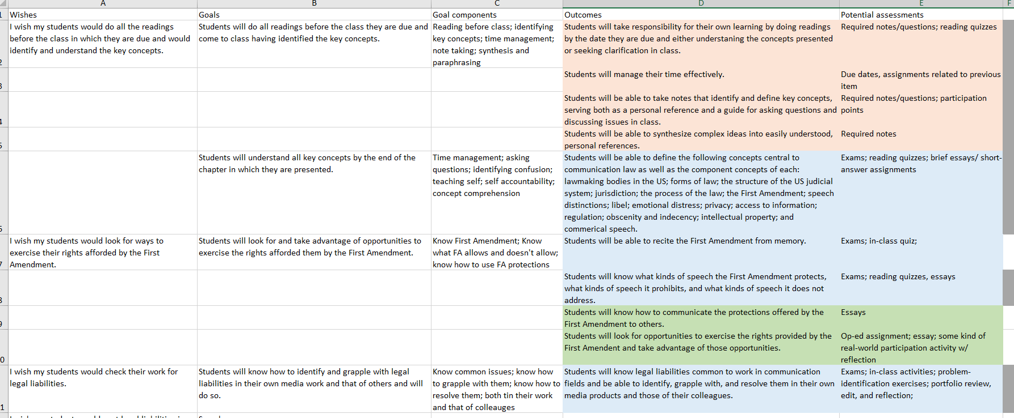

Slide 26
None of my outcomes is “to be able to pass a test on this at their job.”

Slide 27
Ken’s potential assignments
required notes/questions; quizzes; essays, short or long; op-ed assignment; real-world participation; problem-ID exercise; in-class activity; problem-response activity; group discussion; collaborative writing; participation; and on

Slide 28
STEP 2
Identify which assessments must be done and how to make that happen.

Slide 29
Ken’s wish list:

Slide 30
Ken’s wish list:
Regular attendance

Slide 31
Ken’s wish list:
High baseline understanding of core

Slide 32
Ken’s wish list:
Strong writing

Slide 33
Ken’s wish list:
Journalistic writing

Slide 34
Ken’s wish list:
Internalization of First Amendment

Slide 35
Goal | Decision
Regular attendance
High baseline understanding of core
Strong writing
Journalistic writing
Internalization of First Amendment

Slide 36
Goal | Decision
Regular attendance | Perfect attendance = 62 percent (1.5/class)
High baseline understanding of core
Strong writing
Journalistic writing
Internalization of First Amendment

Slide 37
Goal | Decision
Regular attendance | Perfect attendance = 62 percent (1.5/class)
High baseline understanding of core | Quizzes = point-free and mandatory; tickets
Strong writing
Journalistic writing
Internalization of First Amendment

Slide 38
Goal | Decision
Regular attendance | Perfect attendance = 62 percent (1.5/class)
High baseline understanding of core | Quizzes = point-free and mandatory; tickets
Strong writing | High point values, required revision
Journalistic writing
Internalization of First Amendment

Slide 39
Goal | Decision
Regular attendance | Perfect attendance = 62 percent (1.5/class)
High baseline understanding of core | Quizzes = point-free and mandatory; tickets
Strong writing | High point values, required revision
Journalistic writing | High point value
Internalization of First Amendment

Slide 40
Goal | Decision
Regular attendance | Perfect attendance = 62 percent (1.5/class)
High baseline understanding of core | Quizzes = point-free and mandatory; tickets
Strong writing | High point values, required revision
Journalistic writing | High point value
Internalization of First Amendment | High point value for memorization

Slide 41
Goal | Decision
Regular attendance | Perfect attendance = 62 percent (1.5/class)
High baseline understanding of core | Quizzes = point-free and mandatory
Strong writing | High point values, required revision
Journalistic writing | High point value
Internalization of First Amendment | High point value for memorization
but NONE are required

Slide 42
Goal | Decision
Regular attendance | Perfect attendance = 62 percent (1.5/class)
High baseline understanding of core | Quizzes = point-free and mandatory
Strong writing | High point values, required revision
Journalistic writing | High point value
Internalization of First Amendment | High point value for memorization
alternative assessments are devised that further the same or parallel skills

Slide 43
result
a slate of assessments that provides every student with an opportunity to excel

Slide 44
Assessment | Point Value
Score a 50% on a reading quiz before the chapter is discussed in class | 0.5
Turn in the syllabus scavenger hunt | 1
Attend class and have your ticket validated | 1.5
Write an email to your boss | 2.5
Recite the First Amendment from memory on five different days | 5
Write a reflection paper | 5
Participate in a debate | 5
Lead a class session with a group | 10
Write a collaborative research paper | 10
Write an op-ed piece | 10 (15 if published)
Write a research paper | 15

Slide 45
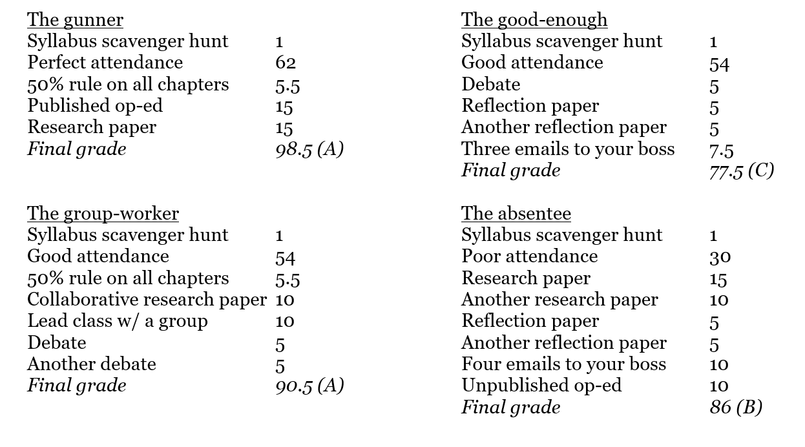

Slide 46
STEP 3
Fill in the gaps with activities in the classroom.

Slide 47
STEP 4
What I didn’t do and should have:
Require students to submit coursework plan 3–4 weeks into semester

Slide 48
1: Work from sound outcomes
2: Incentivize priorities
ASSESSMENT LIST COMPLETE
3: Fill gaps in classroom
4: Coursework plan

Slide 49
WARNINGS

Slide 50
Students will be scared.

Slide 51
Students may reject the grading scheme altogether.

Slide 52
Students will press deadlines (but you can help yourself with this).

Slide 53
Students won’t do some of the assignments you create.

Slide 54
Partial integrations

Slide 55
Partial integrations
Baseline quizzing

Slide 56
Partial integrations
Baseline quizzing
Retakes/revisions

Slide 57
Partial integrations
Baseline quizzing
Retakes/revisions
Let students build assignments

Slide 58
Partial integrations
Baseline quizzing
Retakes/revisions
Let students build assignments
Choose from these 2/3/5

Slide 59
ACTIVITY
Choose a well-constructed outcome from a course you teach (or build one from the ground up).
Brainstorm several assessments that would develop/measure progress toward that outcome.
Which of those assessments would overlap with other outcomes? What alternate assignments would cover the same outcomes?
If you have time, repeat.

Slide 60
LET’S TALK
What do you want to try?
What problems can you envision in your discipline/course that would make additive grading difficult?
Which of the assessments you use right now meet students where they are? How can you model others similarly?

Slide 61
Shifting from Subtractive to Additive Grading to Improve Participation, Comprehension, Creativity, and Morale
Dr. Ken J. Ward, assistant professor of communication and media, Lamar University
kenjward.com | kenneth.ward@lamar.edu | SHSU TLC 2019

